Slide 1
Multiple Sclerosis: A neurodegenerative autoimmune disease
A chronic autoimmune disorder that progressively robs sufferers of cognitive function, the ability to sense the world around them, and the capacity to walk
Overview
Pathophysiology
Therapeutic approaches
Animal Models: EAE to understand the pathology

Slide 2
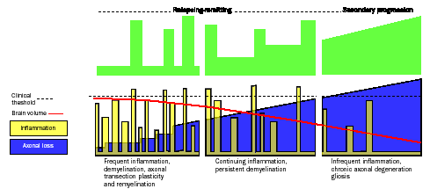
MULTIPLE SCLEROSIS FEATURES
Autoimmune disease of CNS; a two stages disease: inflammation and neurodegeneration
4,000,000 people affected worldwide
Women:men 2:1
Age of disease onset: 25-30 ys (young adulthood)
Neurological impairments: blindness, loss of sensation, lack of coordination, incontinence, paralysis
Relapsing-remitting (80%); chronic progressive (10%); benign (10%)
P. Martini

Slide 3
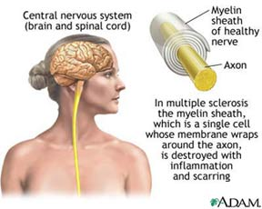
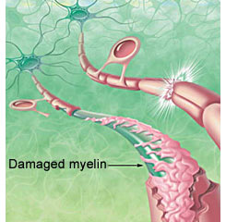
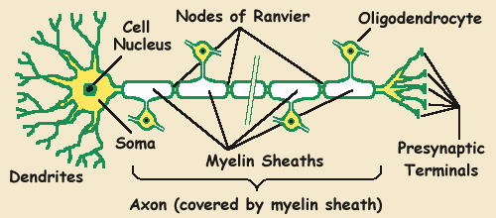
Disease Overview: Multiple Sclerosis
Multiple Sclerosis (MS) is an Inflammatory disease of the Central Nervous System (CNS) affecting the brain and spinal cord. Predominantly, it is a disease of the ”White Matter" tissue. The white matter is made up of nerve fibers which are responsible for transmitting communication signals both internally within the CNS and between the CNS and the nerves supplying rest of the body.
Or Schwann Cells
P. Martini
Notes:
Damage starts immediately upon inception, damage is continuous
Disease is hetegeneous: each person’s progression to disability is different

Slide 4
MS is characterized by:
^{1-Severe demyelination}
^{2-Axonal injury}
3-Formation of lesions in the brain and spinal cord
4-Opening of the blood-brain barrier (BBB)
5-Activation/infiltration of inflammatory immune cell

Slide 5
Three Factors for demyelination
1-T cell activation
2-Antibody mediated demyelination
3-Primary oligodendrocytic death
P. Martini

Slide 6
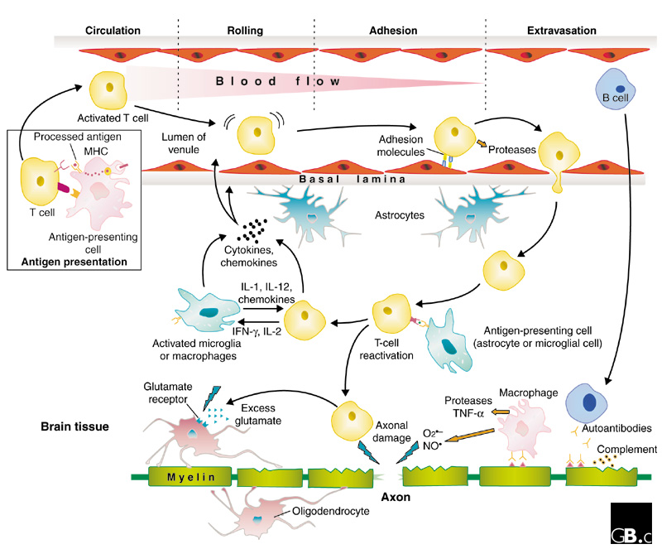
Pathophysiology
Key Takeaways
Reasons why MS occurs is unknown
Pathogenic mechanisms of MS remain poorly understood, thus complicating drug design and development
Even in the earliest stages, the chronically activated proinflam-matory T lymphocytes attack myelin in brain & spinal cord, causing lesions detectable by MRI
P. Martini
Baranzini S.E. et al, Genome Biology 2002: 3(10) 1027.1-1027.5
Notes:
1. Ms is an pathophysiology continues to be poorly understood, which complicates the design and development of new agents
2. Most of the damage occurs early in the disease process and decreases over time, although some destruction can still be observed years and decades afterward. 3. Active lesions represent acute attacks.

Slide 7
How could T cells become reactive in MS?

Slide 8
Disease Overview: AutoImmunity
Peripheral tolerance involves a populations of regulatory T cells which maintain autoreactive T cells in a “dormant” state in the circulation in adults. The autoreactive T cells can be awoken from this state by local or environmental stimuli such as exposure to endogenous or exogenous antigens in the circulation. In MS these cells becomes activated either because of failure of the mechanism of peripheral tolerance or due to priming by antigens. Once activated autoreactive T cells release a cocktails of cytokines that are important for migration and homing of the cells to the target sites and for initiation of the inflammatory process
P. Martini
Hartung H.P., J. Neurol. 2005 (252)
Notes:
Damage starts immediately upon inception, damage is continuous
Disease is hetegeneous: each person’s progression to disability is different

Slide 9
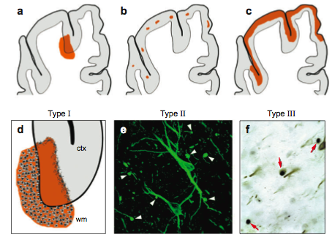
Cortical demyelination and neuronal pathology in MS
W&G matter
Perivascular demyelination
Cortical demyelination
Cortical demyelination
No leukocytes invasion
Transection
apoptosis

Slide 10
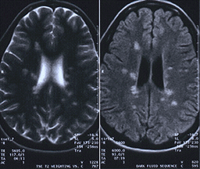
MRI in Multiple Sclerosis (MS)
Image courtesy of Siemens Medical Solutions.

Slide 11
MS Prevalence – US Estimated that 86% of prevalent cases are diagnosed and ~55% are treated
Estimated U.S. Prevalence (000s)
Source: Epi database
Affects 350,000+ US;
No cure; Not a fatal disease, however higher mortality rate vs. age-gender matched population due to Suicide, autonomic nervous system failure, cardiac/ respiratory failure
More common in people in northern latitudes, Northern European decent
MS dramatically affects a person’s quality of life vs duration of life
11
Sources: Multiple Sclerosis: Cognos Study #73. Decision Resources, Inc. October 2003; Iddb, The Changing Face of Multiple Sclerosis Therapy. Rodman & Renshaw Biotechnology Report, March 3, 2006
P. Martini
Notes:
Only 55% of MS pts are currently treated (170k), high drop out rate
Young average age of onset – people could live with MS for decades, therapies safe for long term use
People to die from associated complications, can live a bit less longer – 5-6 yrs
impacts qol, important factors tolerability, live with it a long time

Slide 12
Diagnosis, Clinical Forms, and Treatment
Symptoms
Patient Flow & Diagnosis Criteria
MS Clinical Forms & Classifications
Current Treatment Paradigm
P. Martini

Slide 13
MS Symptoms
Develop during acute exacerbations or as the cumulative result of multiple lesions in the CNS
Symptoms can include: Fatigue (most common), sensory complaints, tremors, balance/coordination, depression, spasticity, bladder, bowel, vision loss, cognitive and emotional dysfunction, and sexual difficulties
Not all symptoms affect all MS patients
No two persons have identical complaints
No one person develops all of the symptoms
CNS Lesion Location and Possible Associated Symptoms of MS:
Lesion Location
Signs/Symptoms
Cerebrum & Cerebellum
Balance problems, depression, speech problems, coordination, tremors, neuritis
Spinal Cord/Motor nerve tracts
Muscle weakness, spasticity paralysis, vision problems, bladder and/or bowel problems
Spinal Cord/ Sensory nerve tract
Altered sensation, numbness, prickling, burning sensation
P. Martini
Notes:
Symptoms vary from patient to patient
Lesion location determines symptoms

Slide 14
Patient Flow
Symptoms
Patient Presentation
Problems with walking/limb control
Altered sensations
Intestinal, bladder incontinence
Visual disturbances
Memory & concentration problems
Extreme fatigue
Lack of sexual energy
Depressions, anxiety, panic attacks, mood swings
Barriers
PCPs
Rarely diagnose
If MS suspected, refer to Neurologist
No clinical, lab, or imaging tests
Misdiagnose, ‘miss it,’ or just don’t screen
Disappearing symptoms
Neurologists
Diagnose
Treat
Manage disease
Psychologists
Nurses
PT/Vocational
Depression (50-60% pts)
Suicide risks (3-15%)
Pts & families often require counseling
Monitoring
Act as “manager” for active disease
SE’s
Disability
To treat associated physical disability
P. Martini
Notes:
A diagnosis of exclusion: no clinical, laboratory, or imaging finding in MS – ultimately a clinical decision based on weighing factors that support the diagnosis Subset of neurologists that focus on MS
depression in multiple sclerosis is not only due to the social and psychologic impact of MS but to the disease process itself

Slide 15
Diagnosing MS
Standard MS Diagnosis Criteria: 1. Disease in different parts of the nervous system, and 2. Signs of at least two separate flare-ups, occurring at least 30 days apart
McDonald Diagnosis Criteria for MS: An Improvement
McDonald Criteria (est. 2001, revised in 2005):
Introduced the following two MS diagnosis classifications: - Definite MS and Possible MS
Allows Neurologists to make definitive diagnosis of MS after the following events:
- CIS (clinically isolated syndrome)
- With MRI findings
McDonald Criteria allows for an early and accurate
MS diagnosis:
Important for patient care – allows early treatment
Impacts clinical trials of new treatments – MRI increasingly used as a primary end point
P. Martini

Slide 16

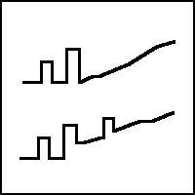


Clinical Forms of MS
Four internationally recognized general categories
Relapsing-remitting (RRMS): 55%
Clearly defined flare-ups & remissions; inflammatory lesions developing constantly
Early 20s & 30s; women 2:1
Initial disease activity in brain (cognitive)
Better prognosis: supporting equipment avg. 20 yrs
Majority of RRMS pts will develop SPMS (90% in 25-30 years)
Secondary Progressive (SPMS): 35%
Relapse frequency decreases but disability increases
Less remyelination & more plaques, resulting in steadily progressive disability with less recovery
Could represent different, advanced stage of RRMS
Primary Progressive (PPMS) 9%
At onset, steady worsening without relapses or remissions
Variations in rates of progression; occasional plateaus or temporary minor improvements
Late 30s/early 40s; men as likely as women
Initial disease activity in spinal cord (physical disability)
Worse prognosis: supporting equipment avg. 6-7 yrs
Progressive Relapsing (PRMS): 1%
From onset steadily worsening disease with clear acute relapses with or without recovery
Unlike RRMS, remission periods contain clinically observable continuing disease progression
P. Martini
Source: National Multiple Sclerosis Society & NIH estimates
Notes:
Familiar with these forms, graphs visually depict disease and disability progression over time – become more meaningful when you take a closer look
RR well defined acute attacks with full recovery, residual neurological deficit est over time – at this stage little or no progression between attacks
3. SP Relapses decline
4. PP we see progression PP progressively increasing disiability from the start w/o relapses,
5. SP a hybrid of these two disease forms (hence the two colors), pts exhibiting periods of intense symptoms, with only MINOR remission in between
Somewhat controversial, 1%

Slide 17
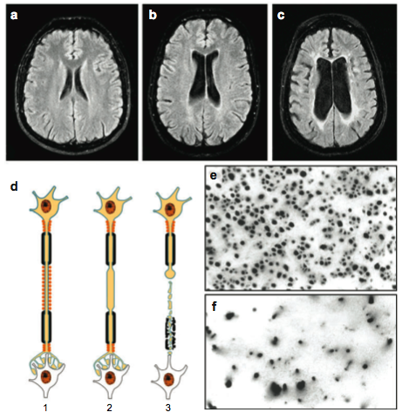
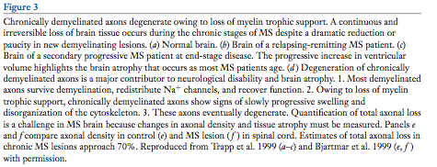
Degeneration of chronically demyelinated axons:
Loss of trophic support. SPMS.
HC
RRMS
SPMS
Axonal density

Slide 18
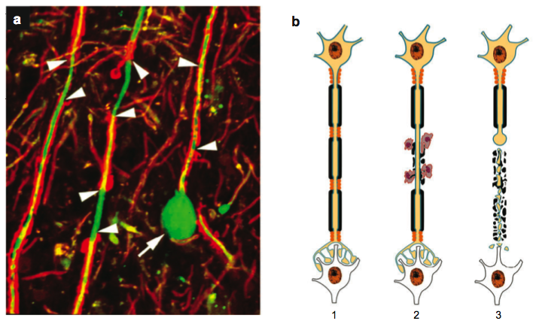
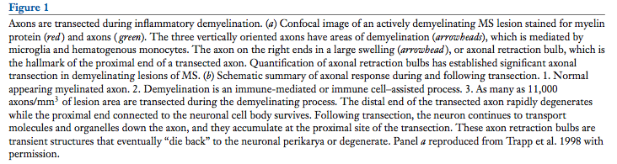
Axons are transected during inflammatory demyelination
Axonal retraction bulb
Proximity end of a retracted axon

Slide 19
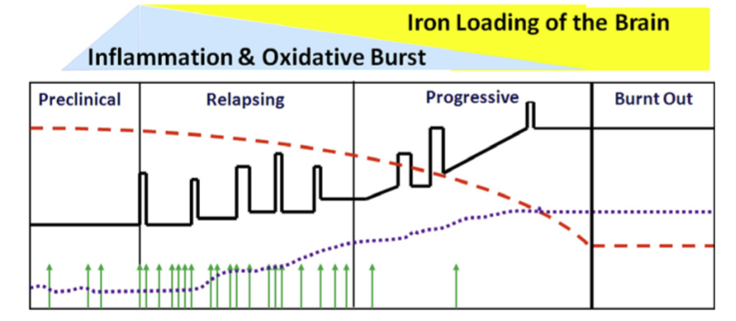
The pathology of MS changes with time
Brain atrophy
Brain Volume
Lesions
Lassmann and Horsen, 2011

Slide 20
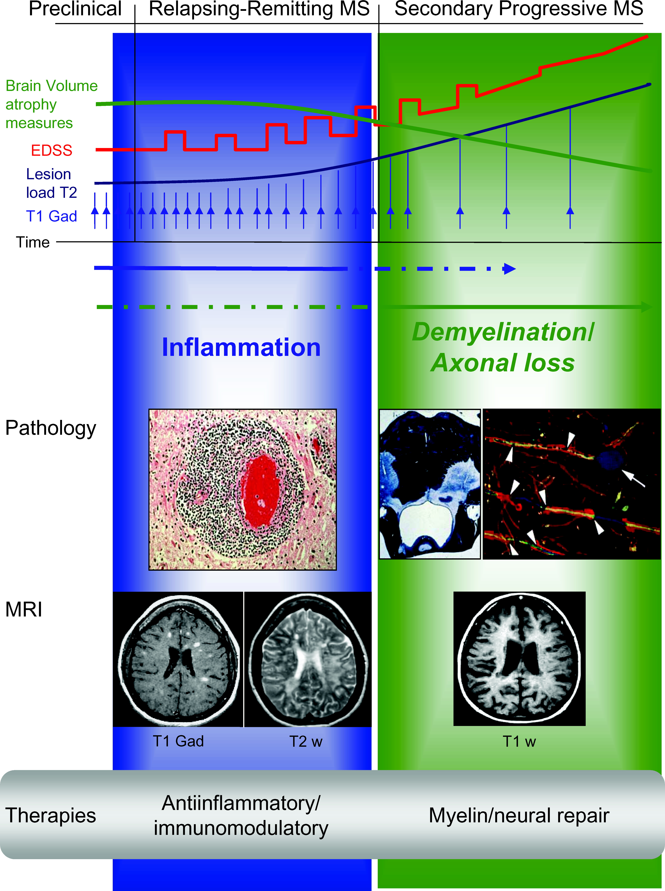
Relapsing MS and Progressive MS
These two classifications are critical to understanding the current & future treatment paradigms
Relapsing MS RRMS, worsening RRMS, SPMS with relapses
Progressive MS SPMS without relapses, PPMS
P. Martini
Sources: National Multiple Sclerosis Society; http://www.multsclerosis.org/progressiverelapsingmultiplesclerosis.html ; Sospedra et al., Annu. Rev. Immunol., 2005: (23) 683-747
Notes:
Some experts think that developing a single agent to treat both forms of MS is impossible, and that a more appropriate strategy is to target the inflammatiory/relapsing and degenerative /progressive components of the disesae.

Slide 21
Relapsing MS
Treatment Overview
Relapsing MS
FIRST-LINE
All approved for Relapsing MS
Disease modifying
Used as monotherapy
IFNβs
Glatiramer acetate
Monoclonal antibody
CONCURRENT THERAPY
Short-term, high-dose corticosteroid treatment
Standard through an acute relapse
Methylprednisolone
Prednisone
SECOND-LINE THERAPIES
First-line tx is not tolerated, non-responders, or worsening relapsing disease
Chemotherapeutics
P. Martini
Notes:
SWAP the efficacy in first line
55% of diagnosed pts treated, where a ~20% drop out of treatment (sometimes referred to as quitters)
Disease modifying =
Reduction in the frequency of attacks
Reduction in the number of of new lesions found on MRI scans, suggesting a decrease in myelin destruction

Slide 22
Progressive MS Treatment Overview
There are no therapies indicated to treat Progressive MS
Progressive MS
FIRST-LINE THERAPIES
Used as monotherapy
IFNβ
Glatirmamer acetate
Chemotherapeutic agents
CONCURRENT THERAPY
Short-term, high-dose corticosteroid treatment
Symptomatic treatment
Methylprednisolone
Prednisone
SECOND- & THIRD-LINE THERAPIES
Polytherapy given to pts who continue to deteriorate despite treatment with first-line therapies
Combinations include:
IFNβ + chemo agent
Glatiramer acetate + chemo agent
BMT & lymphoid irradiation (reserved for most dire cases)
P. Martini
Notes:
Start polytx quickly after mono first
In Progressive MS, inflammation is lessened; myelin, oligos, and nerve cells appear to just die off
Relapsing MS treatments are aimed at reducing inflammation and altering the function of attacking cell

Slide 23
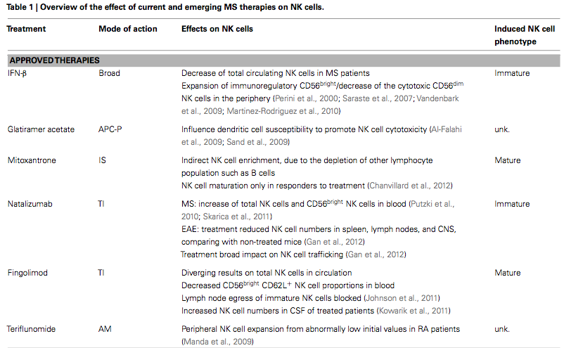
tysabri

Slide 24
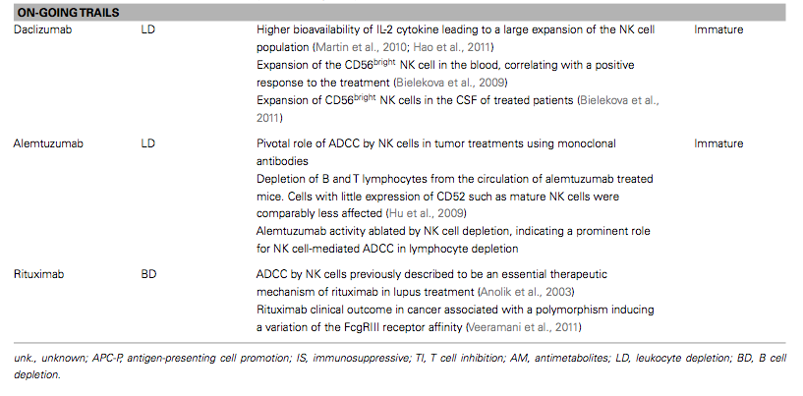

Slide 25
Avonex
Betaseron
Copaxone
Rebif
Tysabri
Novantrone
Top Unmet Needs vs. Current Product Performance
Tysabri Ab against integrins
Reversing neuronal damage
Prevention of disease progression
Improved therapies for Progressive forms of MS
More convenient drug delivery
No current MS therapy addresses neuronal damage - Current therapies moderately effective in slowing disease progression - Relatively little therapeutic effect offered for Progressive MS - Inconvenient drug delivery (injectables, IV infusions)
P. Martini

Slide 26
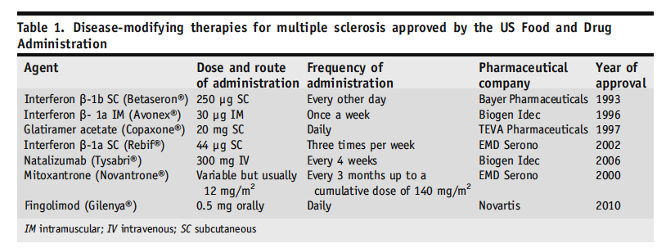
Therapeutic approaches in MS

Slide 27
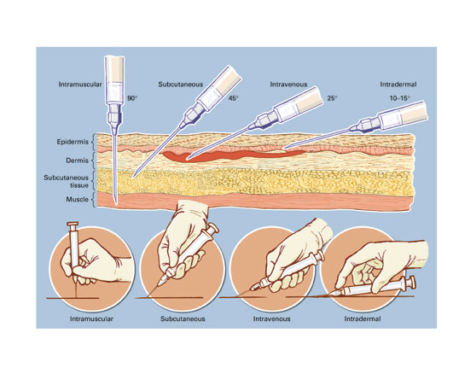
Delivery of MS drugs by injection
info.sanguinebio.com

Slide 28
Top Current Unmet Needs and Future Products
Unmet Need
Current tx
Future tx
Reversing neuronal damage
Prevention of disease progression
Improved therapies for Progressive forms of MS
More convenient drug delivery
- No advances likely to be made in addressing neuronal damage - Little to no advances will be made in slowing disease progression - Potential for improved therapies to treat Progressive MS - Mode of drug delivery likely to be significantly improved
P. Martini

